Slide 1

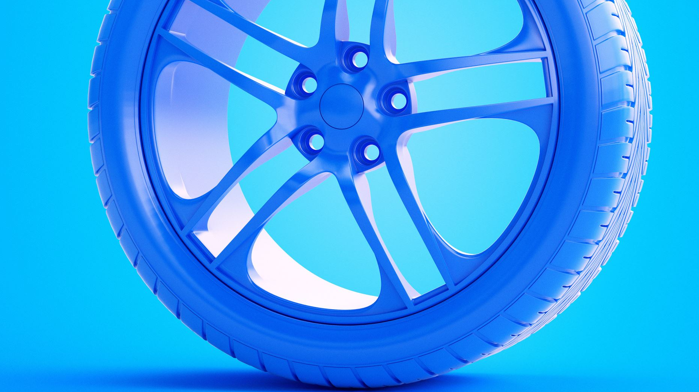
Smart braking system
Project Laboratory
Team: Holdjáró szárnyakkal
Presented by: János Gorondi

Slide 2
Goals for this project
Model based development of a smart braking system
Designed system could brake in time if an object is in front, while preserving the safety of passengers
Steps I took for realization:
Determining high level requirements based of customer requests
Assign high level functions for these requirements
Broke down high level functions into lower-level ones, than realize them with specialized software components
Pair software components with relevant hardware pieces
Implement the system
Test my own module as well as the whole integrated system

Slide 3
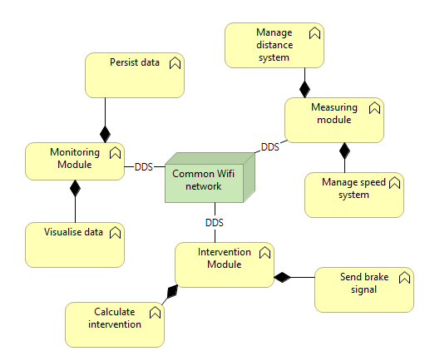
All modules
Measuring module​:
Measures, filters and transmits speed and distance​
Receives brake​, shutdown, reset
Intervention module​:
Receives distance, speed and speed intervention​
Calculates and forwards the amount of brake​
Monitoring module​:
Collects speed, distance and brake data​
Persists data in a database​
Visualize collected data

Slide 4
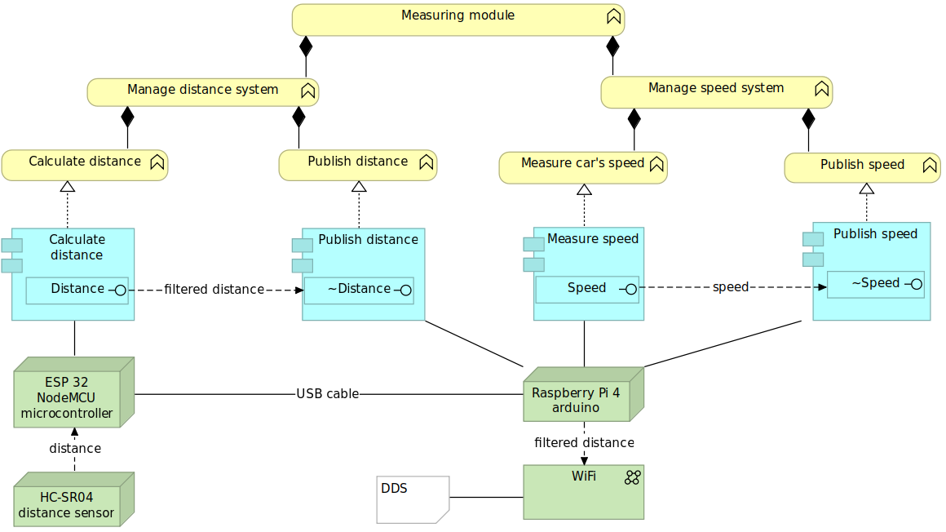
Measuring module
Roles:
Collecting data
Filtering data
Distributing data via DDS
DDS:
Communication middleware in CPS
Publish – Subscribe
Topics inside a Domain
Common network
Notes:
Cyber Phisical Systems: Computer systems in which a mechanism is controlled or monitored by computer-based algorithms.
Middleware: Middleware is software that provides common services and capabilities to applications outside of what’s offered by the operating system. Communication, authentication, and API management are all commonly handled by middleware. Middleware helps developers build applications more efficiently. It acts like the connective tissue between applications, data, and users.
DDS: DDS has various components which all play a role at achieving reliable and fast com- munication within a network. It creates a global data space called Domain, in which the communication takes place. Publishers and Subscribers are the components who send and receive data there. Publishers publish Topics into the domain and Subscribers receive those Topics. Topics are global objects where the exchanged information is stored. They have a distinct type, identifier and a QoS service. The Topics are available to everyone who is in the domain, but only Subscribers who subscribe to the given Topic will receive and use it. The Topics are read by Data Readers and wrote by Data Writers, they can handle the object of a single Topic. These files can largely be generated from platform independent .idl extension files, by the RTI Launcher, which greatly helps development. All components of the DDS communication have to be on the same network (Wi-Fi4) to be able to identify and discover each other.

Slide 5
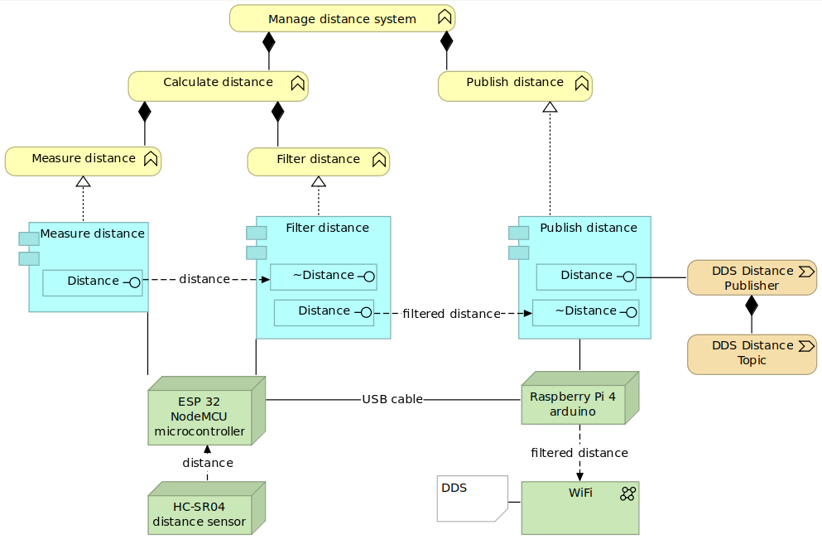


Distance system
Operating sensor
Calculate distance
Filtering algorithm
Serial port communication
Distance Topic
Distance Publisher
Notes:
Filtering on the ESP32 5-10-5
Filtering on Raspberry Pi 4
while (MySerialPort.bytesAvailable() <= 12) message = message.split("\\n")[1]; if(message.length()>=4){

Slide 6
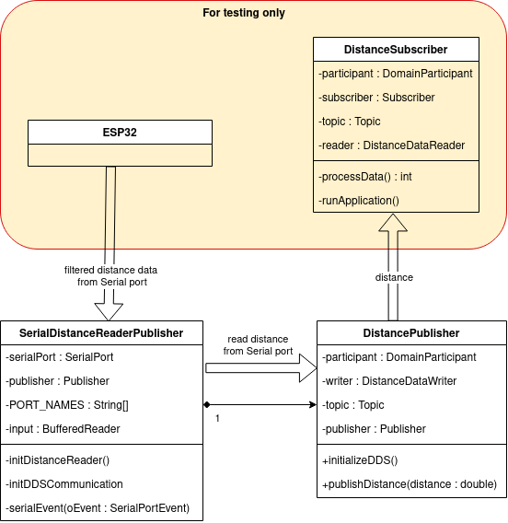
Flow of distance data
Whole subsystem

Slide 7
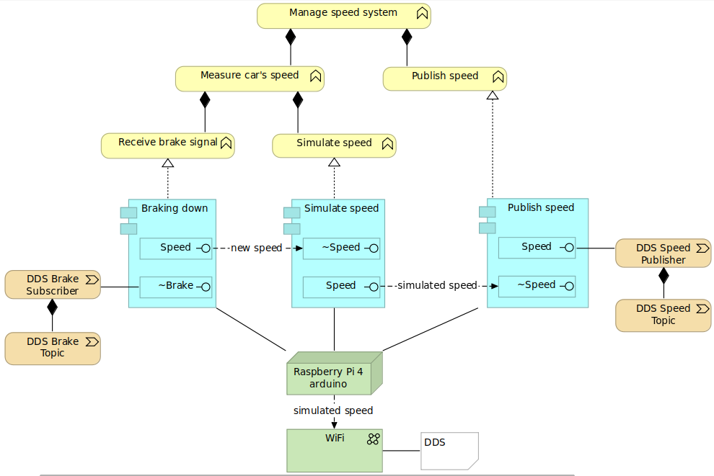




Speed system
Realistic simulation of speed
Receive and process brake, shutdown and reset signals

Slide 8
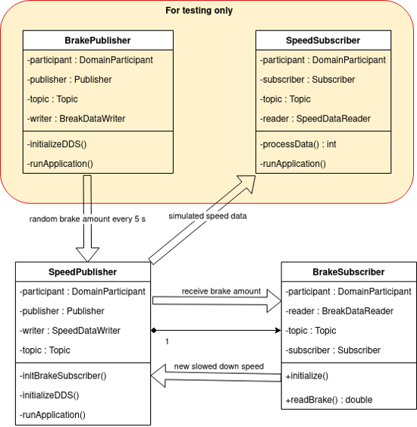
Flow of speed data
Whole subsystem

Slide 9
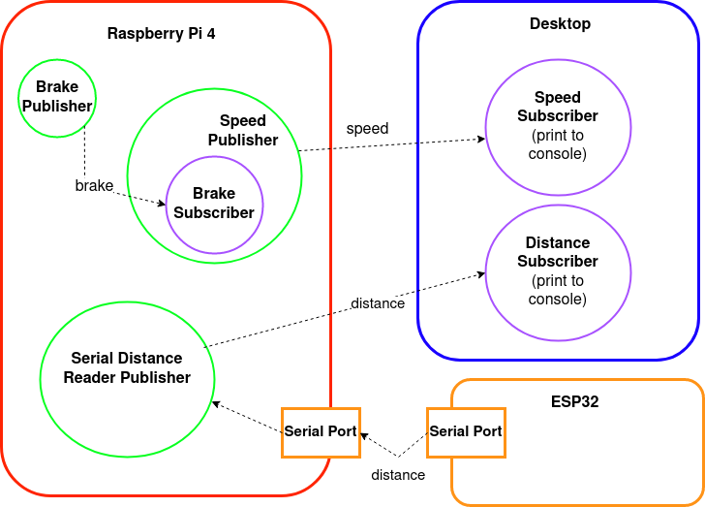
Measuring module data flow
Local desktop development
Raspberry Pi 4 migration
Testing
Learned new skills, technologies:
Linux
Working with microcontrollers and SBC-s
DDS
LaTeX
Notes:
Arduino: Arduino boards are microcontrollers, not full computers with their own operating system like Raspberry Pi. They simply execute code written in C/C++, stored in their firmware. Arduino Integrated Development Environment (IDE) is a great tool for developers.
Raspberry Pi: A small, fully functional computer that can be plugged into a computer monitor, keyboard, and mouse. It has all qualities of a PC- a dedicated processor, memory, and a graphics driver. It even has its own operating system called Raspberry Pi OS which is an optimized version of Linux.
Raspberry Pi does not offer storage, but you can use microSD cards to store whatever OS (Raspberry Pi, Ubuntu etc) you like. Raspberry Pi also contains Bluetooth, ethernet, and WiFi-based connectivity, so it can also be used to transfer files over the internet. Since a Raspberry Pi board is no less than an entire computer inside a Printed Circuit Board, it is often called Single Board Computer or SBC.

Slide 10
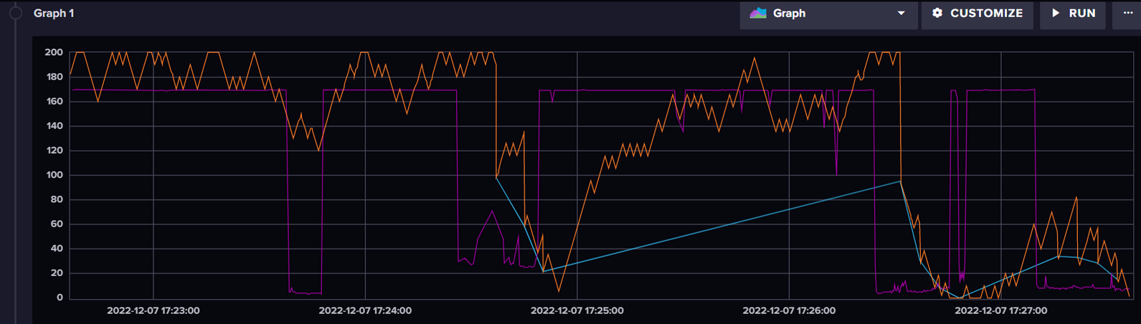
Smart braking system integration
Orange: Car's current speed
Purple: Distance from object in front
Blue: Braking amuont
Notes:
SHUTDOWN, RESET

